Slide 1
Advanced Android Development course
Brought to you by the Google Developers Training team

Slide 2
Contents
Welcome to our new Advanced Android Development course
What will you learn in this course?

Slide 3
Introduction

Slide 4


Next steps in the Android developer journey
Android Developer Fundamentals
Take off on your journey to becoming an Android app developer
Advanced Android Development
Now go deeper into advanced Android development concepts

Slide 5
Who is the audience for this course?
Java programmers who have basic knowledge of building Android apps
Preferred: Developers who have taken the Android Developer Fundamentals course

Slide 6
About the course
Takes you to the next level of Android development
Intended to be an instructor-led course
All materials are available online
Self-motivated learners can work through practicals on their own

Slide 7
Materials
Concepts guide
Practicals
Slides
Source code in GitHub
Everything is available online
Released under Creative Commons License

Slide 8
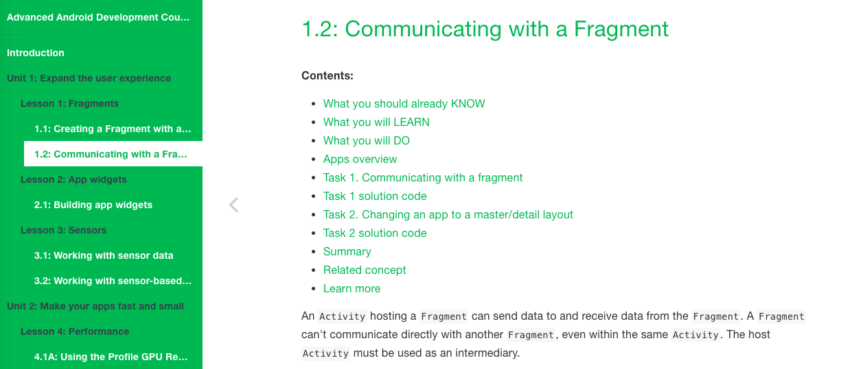
Step-by-step practicals

Slide 9
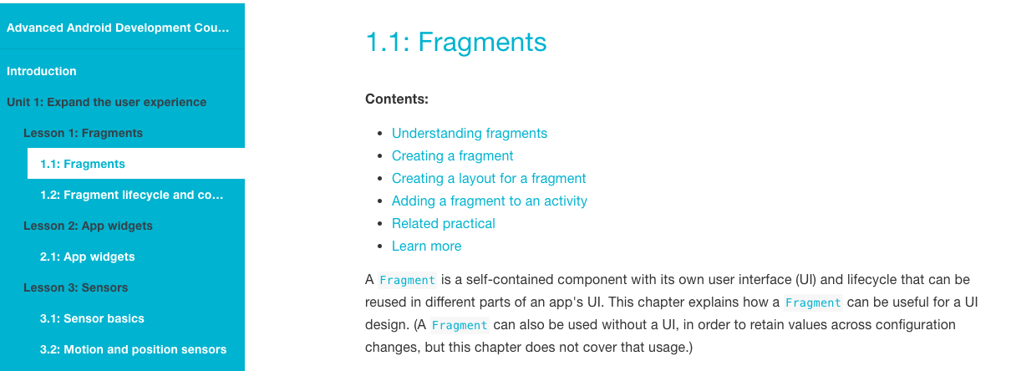
Concepts guides

Slide 10
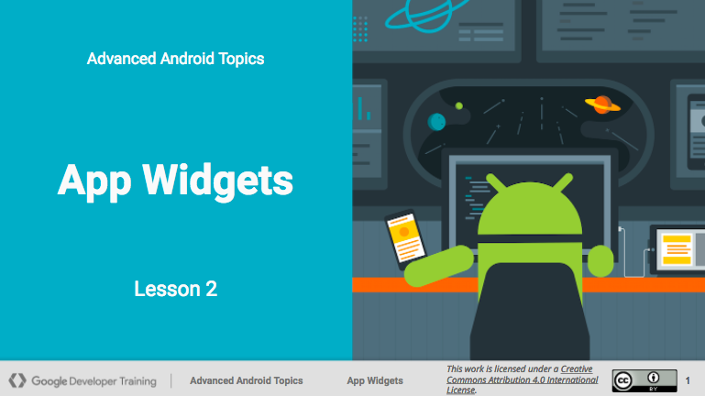
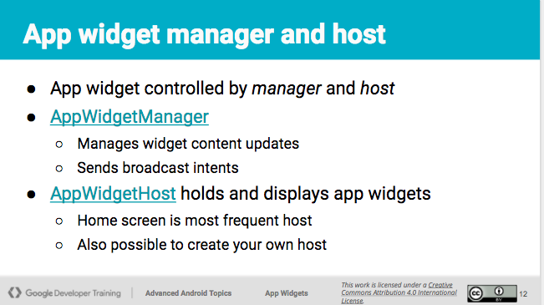
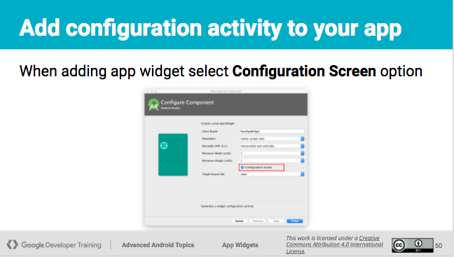
Slide decks

Slide 11
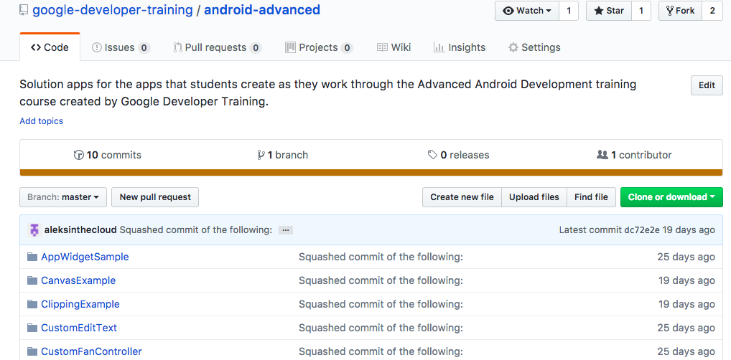
Source code for sample apps in GitHub

Slide 12
Course structure
Course is divided into units
Each unit is independent of other units
You choose:
Teach the whole course
Teach specific units
Add units to your existing Android dev curriculum

Slide 13
What does the course cover?
Unit 1: Expand the user experience
Unit 2: Make your apps fast and small
Unit 3: Make your apps accessible
Unit 4: Add geo features to your apps
Unit 5: Advanced graphics and views
More units coming in early 2018, including media playback

Slide 14
Unit 1
Expand the user experience

Slide 15
Expand the user experience
In Android Developer Fundamentals you learned how to use layouts to display activities.
Now learn about fragments, widgets, and sensors to improve the experience your users have with your app.

Slide 16
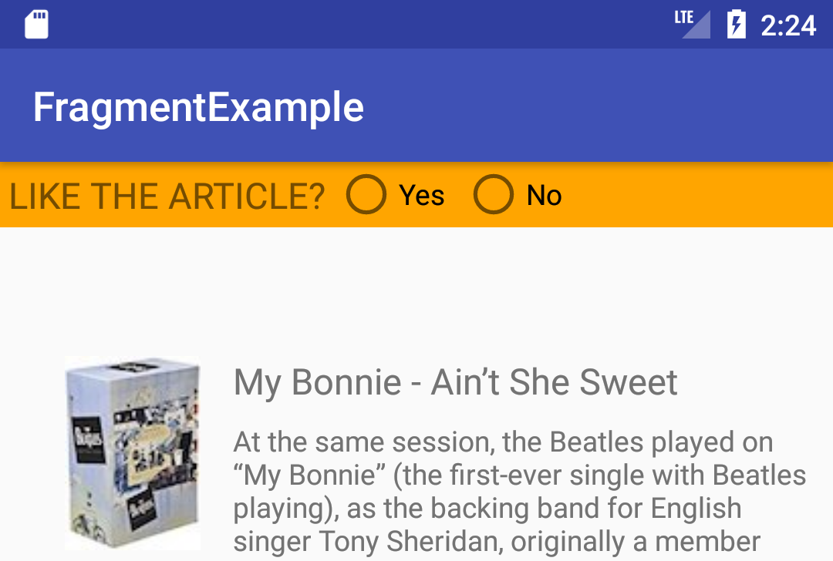
Lesson 1.1 Fragments
Learn that a fragment:
Represents a section of a UI
Can be reused
Is created statically in XML or dynamically in code
Build an app:
Use a fragment to get user feedback

Slide 17
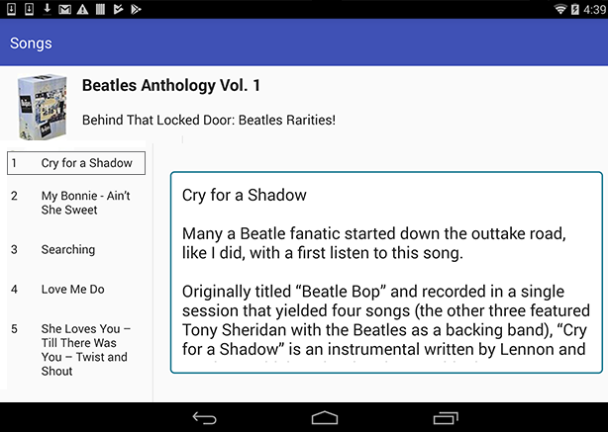
1.2 Communicating with fragments
Learn how to:
Send data to and from fragments
Implement master/detail layout for wide screens
Build an app:
Use fragment to show song details

Slide 18
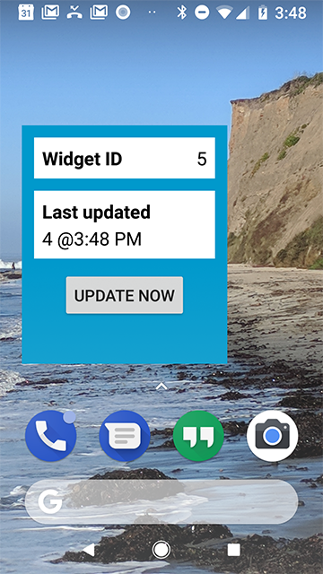
2.1 App widgets
Learn how to:
Implement a widget for your app
Make the widget respond to user actions
Build an app:
App widget updates automatically and on demand

Slide 19
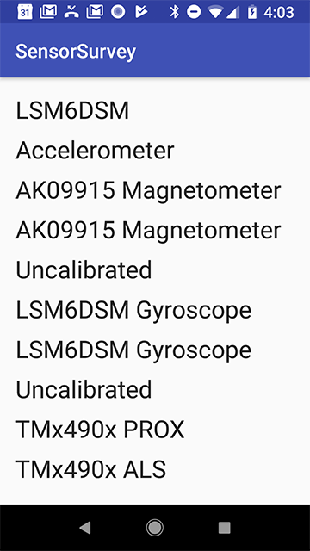
3.1 Working with sensor data
Learn how to:
Get available sensors
Register listeners for sensor data
React to incoming sensor data
Build apps:
Display all available sensors
Display data from light and proximity sensors

Slide 20
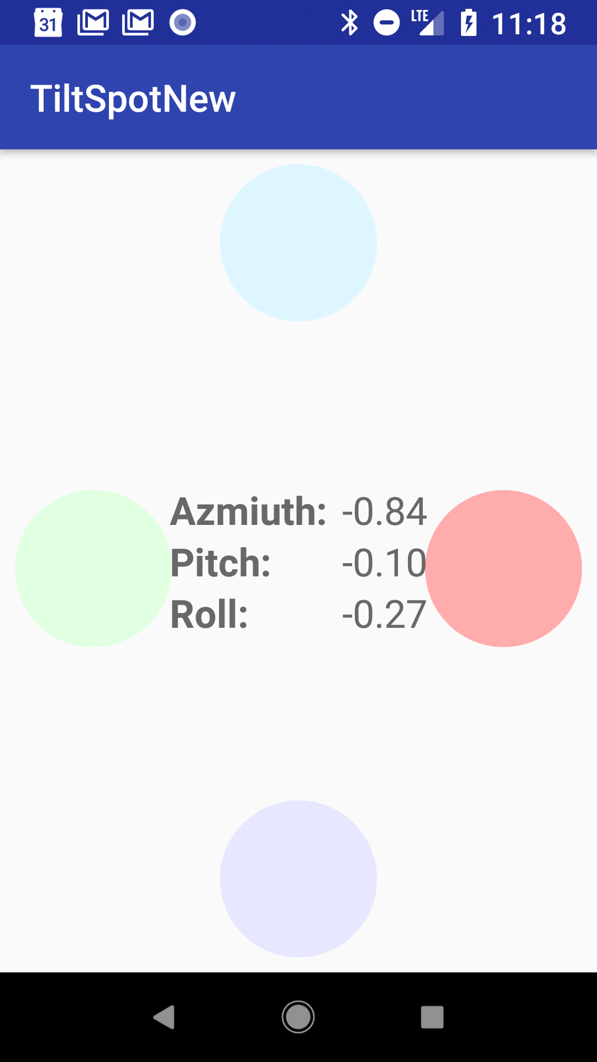
3.2 Sensor-based orientation
Learn about:
Accelerometer and magnetometer
Sensor coordinate systems
Build an app:
Display shapes to show angles and orientation detected by accelerometer and magnetometer

Slide 21
Unit 2
Performance: Make your apps fast and small

Slide 22
Make your apps fast and small
What is good app performance, and why does it matter?
Learn how to keep your app fast and small so your users stay engaged. Use tools to measure performance and identify how to improve it.

Slide 23
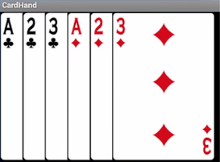
4.1 Performance: Rendering and layout
Learn about:
How layout and drawing affects your app's performance
Tools to detect performance problems
Do:
Use tools to analyze drawing performance
Overdraw is drawing one pixel on top of another

Slide 24
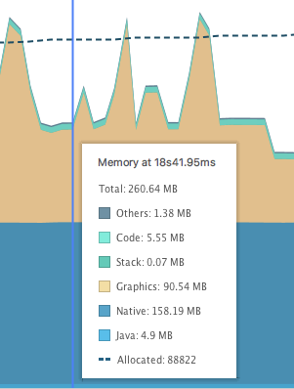
4.2 Performance: Memory
Learn about:
Memory leaks
The Memory Profiler tool
Do:
Use the Memory Profiler tool

Slide 25
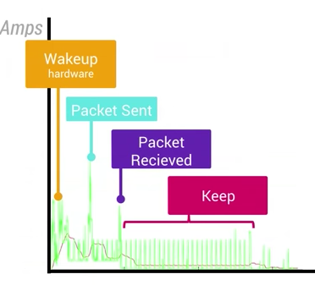

4.3 Network, battery, image performance
Learn about:
Text and image performance
What affects battery drain
Network best practices
Do:
Run the Network Profiler tool
Use battery visualization tools
Convert images to WebP format

Slide 26
Unit 3
Unit 3: Make your apps accessible

Slide 27
Make your apps accessible
Make your apps accessible to users with varying abilities, and in different languages and locales.
Accessible apps reach more users.

Slide 28
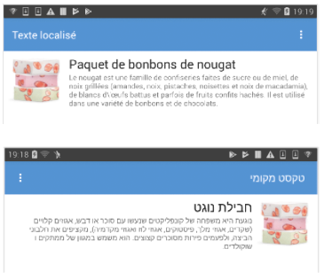
5.1 Languages and layouts
Learn how to:
Support different languages
Build an app:
Use Translations Editor to add translations
Add support for right-to-left languages

Slide 29
5.2 Locales
Learn about:
Locales
Formatting dates, times, numbers, currencies
Build an app:
Show date, quantity, and price of candy in the user's locale
6/8/2017
?
6 of August?
8 of June?

Slide 30
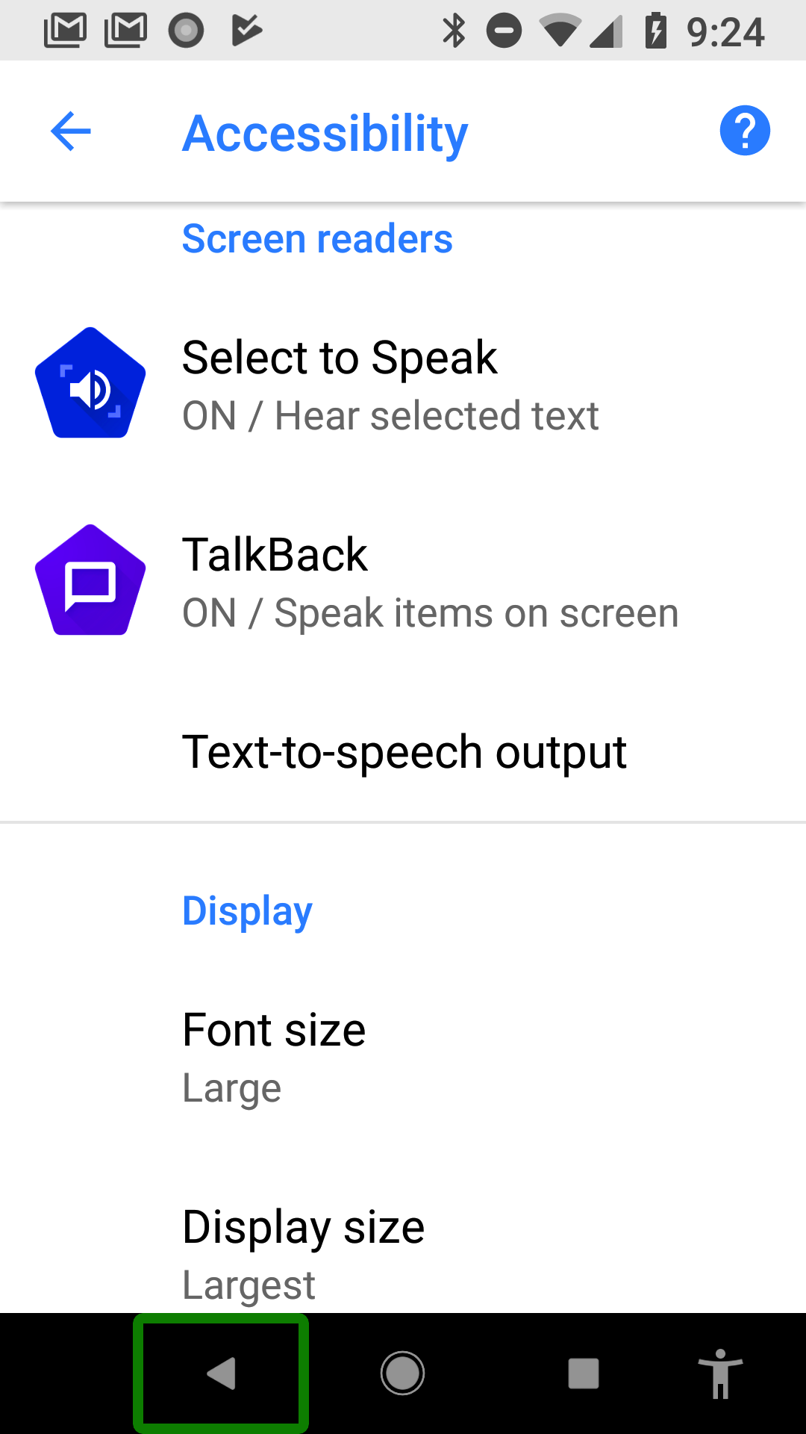
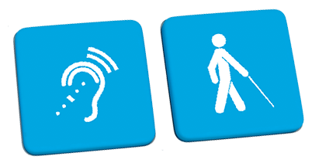
6.1 Accessibility
Learn about:
Accessibility features in Android
Best practices for making accessible apps
Do:
Explore accessibility features on your device
Use Google Talkback
Test your app's accessibility

Slide 31
Unit 4
Add geo features to your app

Slide 32
Add geo features to your apps
Did you know that you can add many of the features provided by Google Maps to the Android apps you build?
This unit shows how to detect and show the user's location, show nearby places, and insert maps into your apps.

Slide 33
7.1 Location
Learn how to:
Get the device's location
Get address from longitude and latitude
Update the location
Build an app:
Update the user's location as they walk

Slide 34
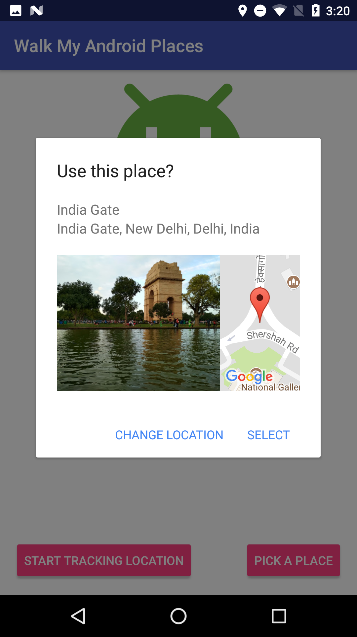
8.1 Places API
Learn how to:
Use Places in your app
Build an app:
Show a list of nearby places
Update UI depending on kind of place

Slide 35
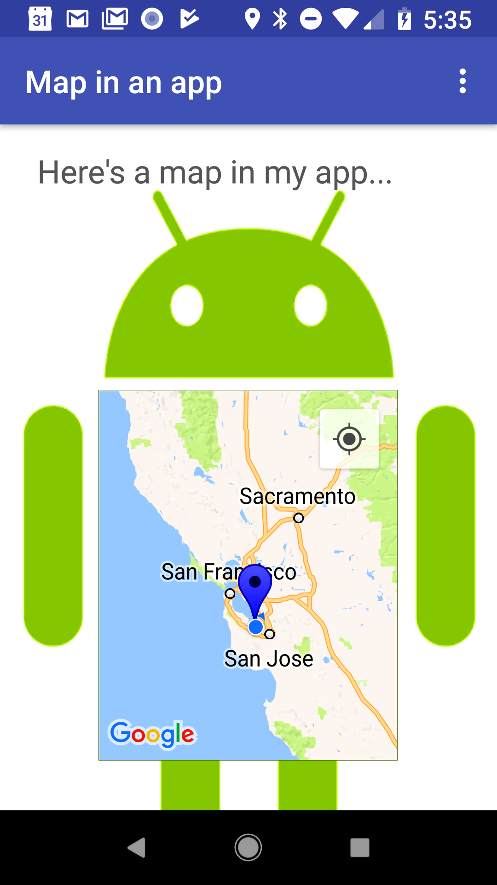
9.1 Add a Google Map to your app
Learn about:
Integrating Google Maps in your app
Map types and styles
Markers and points of interest
Build an app:
Add map types and markers
Style your map
Enable location tracking and Street View

Slide 36
Unit 5
Advanced graphics and views

Slide 37
Advanced graphics and views
Android Studio comes with lots of predefined views, from buttons to seek bars. You can customize their appearance with attributes and use drawables for customized backgrounds.
But sometimes you want even more control over the way your UI elements are rendered.
This unit teaches advanced graphics and views to help you draw exactly the UI elements you have in mind.

Slide 38
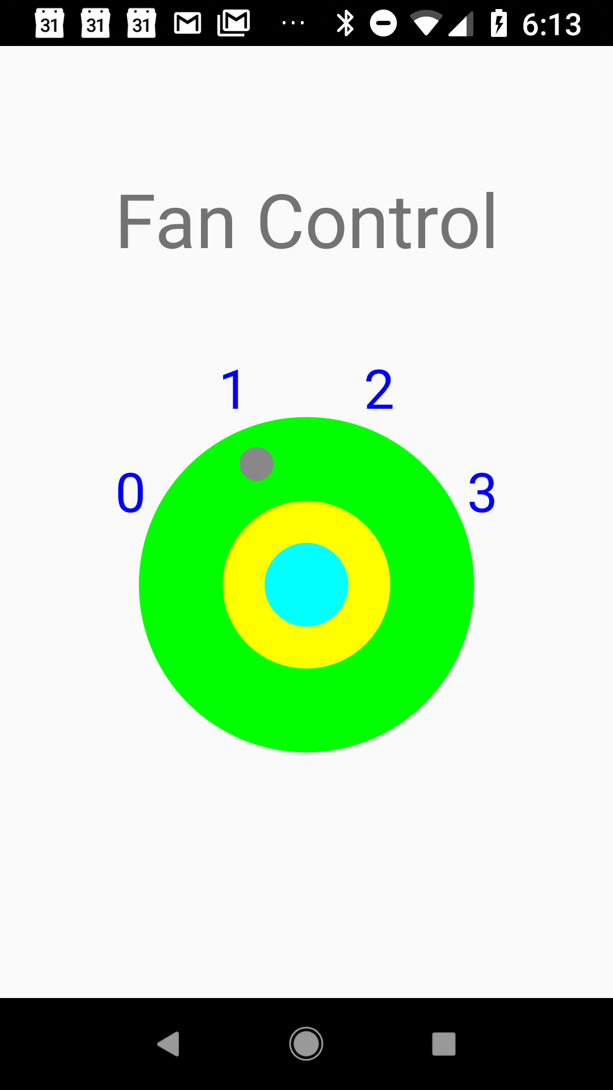
10.1 Custom views
Learn about:
Custom views — when, why, how
Build an app:
Create a custom TextEdit view
Create a custom fan-controller view

Slide 39
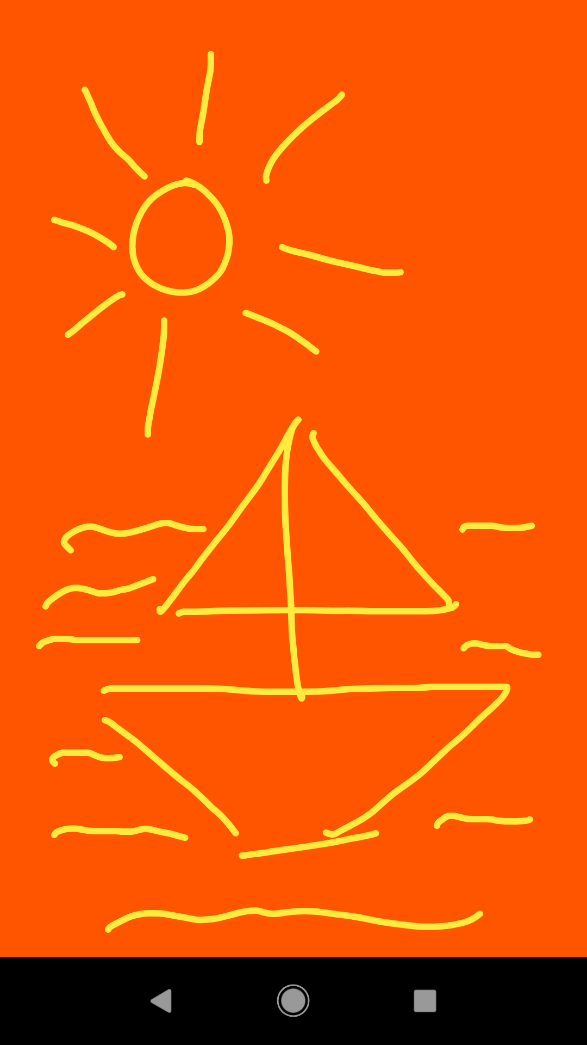
11.1 Canvas
Learn about:
Canvas, Paint
Clipping regions
Responding to button clicks
Build an app:
Simple canvas app
Let user draw sketches
Canvas with different clipping regions

Slide 40
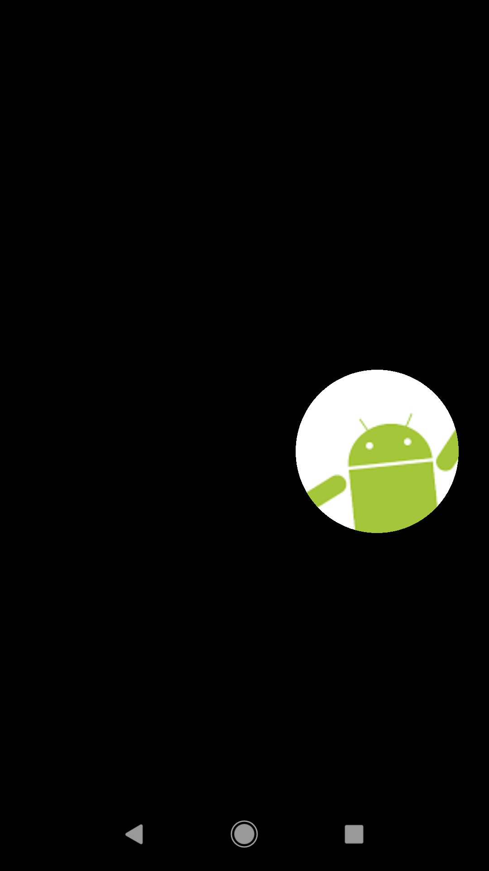
11.2 SurfaceView
Learn how to:
Use SurfaceView to perform drawing operations outside the main thread
Build an app:
Search for an Android robot hiding in the dark

Slide 41
12.1 Animation
Learn about:
Different kinds of animation in Android
Creating property animators
Use AnimatorSets to play multiple animations
Build an app:
Animate a circle expanding and shrinking

Slide 42
Where is everything?

Slide 43
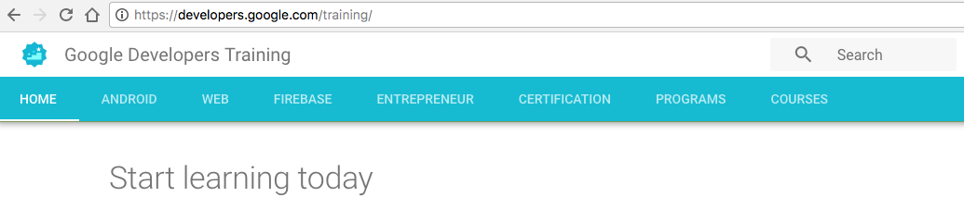
Google Developers Training website
To find all the materials for the course go to:
developers.google.com/training
Go to COURSES tab

Slide 44
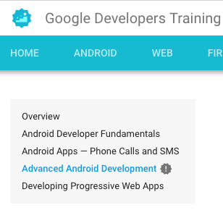
Choose the course
In the left hand menu, choose
Advanced Android Development

Slide 45
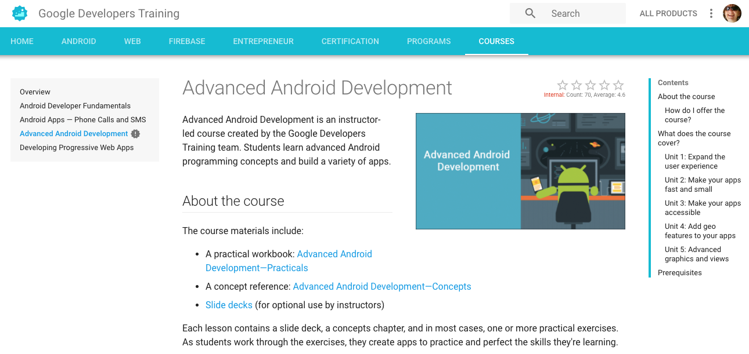
Advanced Android Development

Slide 46
END

